Slide 1


Datasets & APIs
Damian Gordon

Slide 2
Datasets
For this project you need a dataset.
Two ways of getting a dataset are:
Finding an existing one
Generating a new one
Option 1 is waaaaay easier, but it can be often difficult to find the exact dataset you need.

Slide 3
Datasets
For this project you need a dataset.
Two ways of getting a dataset are:
Finding an existing one
Generating a new one
Option 1 is waaaaay easier, but it can be often difficult to find the exact dataset you need.
But more often than not, it’s both.

Slide 4
Datasets
Ways to get data:
Downloads and Torrents
Application Programming Interfaces
Web Scraping

Slide 5
Datasets: Existing ones
Data journalism sites that makes the data sets used in its articles available online
FiveThirtyEight
https://github.com/fivethirtyeight/data
BuzzFeed
https://github.com/BuzzFeedNews/everything

Slide 6
Datasets: Existing ones
Some I.T. companies provide tonnes of datasets, but you need to set-up a (free) login:
Amazon/AWS
https://registry.opendata.aws/
Google
https://cloud.google.com/bigquery/public-data/

Slide 7
Datasets: Existing ones
Some social sites have full site dumps, often including media
Wikipedia: Media
https://meta.wikimedia.org/wiki/Mirroring_Wikimedia_project_XML_dumps#Media0
Wikipedia: Full Site Dumps
https://dumps.wikimedia.org/
Reddit: Submission Corpus 2016
https://www.reddit.com/r/datasets/comments/3mg812/full_reddit_submission_corpus_now_available_2006/

Slide 8
Datasets: Existing ones
Governments sites with data
Ireland
https://data.gov.ie/
UK (get it before it brexits)
https://data.gov.uk/
USA
https://www.dataquest.io/blog/free-datasets-for-projects/

Slide 9
Datasets: Existing ones
Some sites have lots of data, but they need a bit of cleaning
The World Bank datasets
https://data.worldbank.org/
Socrata
https://opendata.socrata.com/

Slide 10
Datasets: Existing ones
Academic Sites that provide datasets
SAGE Datasets
https://methods.sagepub.com/Datasets
Academic Torrents
(all sorts of data, in all kinds of state)
https://academictorrents.com/

Slide 11
Datasets: Existing ones
Lists of datasets
https://libraryguides.missouri.edu/c.php?g=213300&p=1407295
https://guides.lib.vt.edu/c.php?g=580714
https://libguides.babson.edu/datasets
https://piktochart.com/blog/100-data-sets/

Slide 12
Tools & APIs

Slide 13
Web Scraping versus APIs
APIs (Application Programming Interfaces) are an intermediary that allows one software to talk to another.
In simple terms, you can pass a JSON to an API and in return, it will also give you a JSON.
Now there will always exist a set of rules as to what you can send in the JSON and what it can return.
These rules are strict and can’t change unless someone actually changes the API itself.
So when using an API to collect data, you will be strictly governed by a set of rules, and there are only some specific data fields that you can get.

Slide 14
Datasets: APIs
Data journalism sites that have APIs
ProPublica
https://www.propublica.org/datastore/apis

Slide 15
Datasets: APIs
Social Media sites that have APIs
Twitter
https://developer.twitter.com/en/docs

Slide 16
Datasets: APIs
Government sites that have APIs
Ireland
https://data.gov.ie/pages/developers
UK
https://content-api.publishing.service.gov.uk/#gov-uk-content-api
USA
data.gov/developers/apis
OECD
https://data.oecd.org/api/

Slide 17
Datasets: APIs
Data sites that have APIs
data.world
https://apidocs.data.world/api
Kaggle
https://www.kaggle.com/docs/api

Slide 18
Datasets: APIs
Other sites that have APIs
GitHub
https://developer.github.com/v3/
Wunderground (weather site, needs login)
https://www.wunderground.com/login

Slide 19
Datasets: APIs
Creating a dataset using an API with Python
https://towardsdatascience.com/creating-a-dataset-using-an-api-with-python-dcc1607616d

Slide 20
Datasets: Tools
Good Analytics tools to distribute the processing across multiple nodes.
Apache Spark
https://spark.apache.org/
Apache Hadoop
http://hadoop.apache.org/

Slide 21
Web Scraping versus APIs

Slide 22
Web Scraping versus APIs
Web scraping is much more customizable, complex and is not governed by any set rule.
You can get any data that you can see on a website using a scraping setup.
As for how you can scrape data, you can apply any techniques available, and you are constrained only by your imagination.

Slide 23
Web Scraping versus APIs
In other words…
If you know what you are looking for, and you are repeatedly looking to get the same data, from the same source for fulfilling the specific objective … go with APIs
But if you need a scenario that is more customizable, complex and is not governed by any set rule … you can get any data that you can see on a site using a web scraper

Slide 24
Web Scraping

Slide 25
Datasets: Python
Some web spider code, and great videos
http://damiantgordon.com/Videos/ProgrammingAndAlgorithms/SearchEngine.html

Slide 26
Datasets: Python
Five Python Libraries for Scraping:
The Requests library
https://2.python-requests.org//en/master/user/quickstart/
Beautiful Soup 4
https://www.crummy.com/software/BeautifulSoup/bs4/doc/
Lxml
https://lxml.de/index.html#introduction
Selenium
http://thiagomarzagao.com/2013/11/12/webscraping-with-selenium-part-1/
Scrapy
https://scrapy.org/

Slide 27
Datasets: Web Scarping
Some general advice on web scraping:

Slide 28
Datasets: Web Scarping
Robots.txt
Check if the root directory of the domain has a file in it called Robots.txt
This defines which areas of a website crawlers are not allowed to search.
This simple text file can exclude entire domains, complete directories, one or more subdirectories or individual files from the search engine crawling.
Crawling a website that doesn’t allow web crawling is very, very rude (and illegal in some countries) so it should not be attempted.

Slide 29
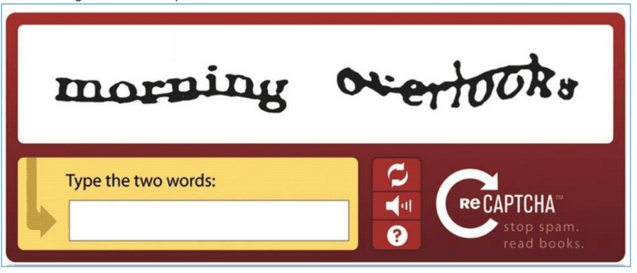
Datasets: Web Scarping
CAPTCHAs
A lot of websites have CAPTCHAs, and they pose real challenges for web crawlers
There are tools to get around them, e.g.
http://bypasscaptcha.com/
Note that however you circumvent them, they can still slow down the scraping process a good bit.

Slide 30
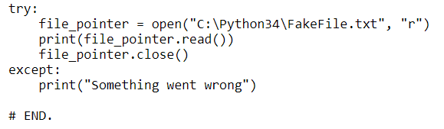
Datasets: Web Scarping
EXCEPTION HANDLING
I’m speaking for myself here …
Very often I leave out the exception handling, but in this particular circumstance, catch everything you can.
You code will bomb from time to time, and it’s a good idea to know what happened.
Also try to avoid hard coding things, make everything as parameterised as possible

Slide 31
Datasets: Web Scarping
IP BLOCKING
Sometimes websites will mistake a reasonably harmless crawler for something more malignant, and will block you.
When a server detects a high number of requests from the same IP address or if the crawler makes multiple parallel requests it may get blocked
You might need to create a pool of IP addresses, or spoof a user agent
http://www.whatsmyuseragent.com/

Slide 32
Datasets: Web Scarping
DYNAMIC WEBSITES
New websites use a lot of dynamic coding practices are not crawler friendly.
Examples are lazy loading images, infinite scrolling and product variants being loaded via AJAX calls.
This type of websites are even difficult to crawl

Slide 33
Datasets: Web Scarping
WEBSITE STRUCTURE
Websites that periodically upgrades their UI can lead to numerous structural changes on the website.
Since web crawlers are set up according to the code elements present at that time on the website, the scrapers would require changes too.
Web scrapers usually need adjustments every few weeks, as a minor change in the target website affecting the fields you scrape, might either give you incomplete data or crash the scraper, depending on the logic of the scraper.

Slide 34
Datasets: Web Scarping
HONEYPOT TRAPS
Some website designers put honeypot traps inside websites to detect and trap web spiders,
They may be links that normal user can’t see and a crawler can.
Some honeypot links to detect crawlers will have the CSS style “display: none” or will be colour disguised to blend in with the page’s background colour.

